Slide 1

Positioning Systems
The project and presentation is based on the paper: “Implementation in Matlab of a Multilplicative Extended Kalman Filter for live estimation of a smart device attitude”
And by the help of “phyphox” app developed by RWTH Aachen University
Authors of the paper:
Javier Utrera, Rafael Vasquez
Presentation is made by Mohammad Eqbal Balaghi, Mat no 242602
DIMES - Univ. della Calabria
blgmmm95e06z200t@studenti.unical.it
April 2024

Slide 2
Summary
Introduction
A review of Kalman filter and some of its Non-linear variations
Attitude estimation
Implementation of MEKF Matlab code
Conclusion

Slide 3
Introduction
The Kalman filter, a powerful tool for predictive and corrective systems in control theory, has found substantial application in aerospace engineering, particularly for navigation and control of aircraft and spacecraft. By efficiently processing noisy measurements to estimate the state of a dynamic system, it enables precise determination of vehicle positions, velocities, and attitudes.
We have leveraged this algorithm to develop an innovative attitude estimation application, utilizing data from Inertial Measurement Units (IMU) to estimate the orientation or attitude of a mobile device. The phyphox app developed by RWTH Aachen University in Germany, demonstrates the practical utility of the Kalman filter in a hands-on, accessible manner. By processing the IMU sensor data, which includes accelerometers, gyroscopes, and magnetometers, the app can determine the device's pitch, roll, and yaw in in an offline mode. This means it doesn't rely on real-time data transmission but instead uses pre-recorded sensor data to perform estimations.

Slide 4
Introduction
This application not only showcases the Kalman filter's applicability in aerospace for tasks like navigation, guidance, and control but also serves as an educational tool, allowing users to understand and visualize the principles of attitude estimation in a tangible way. The ability to accurately estimate the attitude of a device like a smartphone using the same principles applied in guiding rockets and aircraft underscores the versatility and power of the Kalman filter in solving complex engineering problems.

Slide 5
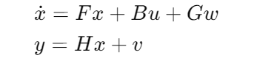
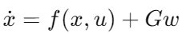
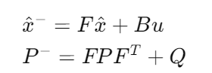
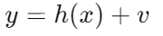
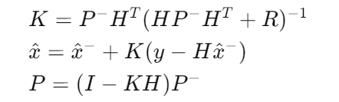
2. A review of Kalman Filter and some of its Non linear Variation:
2. Extended Kalman filter: EKF extends KF to nonlinear systems by linearizing about the current estimate. Essential for complex aerospace models where linear assumptions fail.
Linear Kalman filter fundementals:
System Dynamics Model (Continuous):
Non linear dynamics:
Prediction phase:
Non linear Measurement:
Update phase:
Similar to KF but uses F and H matrices for prediction and update equations to accommodate nonlinearity.

Slide 6
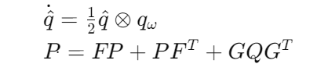
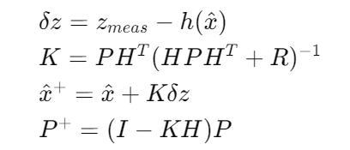
2.1. Multiplicative Extended Kalman filter:
Application Context: Specifically tailored for estimating the attitude of aerospace vehicles or smart devices, using orientation data from gyroscopes, accelerometers, and magnetometers.
MEKF Highlights:
Adapts EKF to orientation estimation, employing quaternions for state representation to handle the rotational kinematics naturally and efficiently.
Utilizes a multiplicative error model to maintain the unitary constraint of quaternions, enhancing estimation accuracy for orientation states.
Key Equations and Implementation
State Propagation Model:
Measurement update model

Slide 7
3. Attitude Estimation :
Attitude Estimation with MEKF: The goal is to estimate the attitude (orientation) of a smart device in off-line using gyroscopes for angular velocity measurements, and accelerometers and magnetometers for gravity and magnetic field direction measurements, respectively. It is assumed that external accelerations (other than gravity) and magnetic field perturbations are negligible.
Kalman Filter Application: The Kalman Filter (KF) variants, especially the Multiplicative Extended Kalman Filter (MEKF), are applied to optimally integrate and combine sensor measurements. MEKF is particularly chosen for its effectiveness in attitude estimation, where orientation is represented through quaternions—a mathematical construct that extends complex numbers to four dimensions, offering a compact and non-singular representation of orientation in 3D space.
Frames of Reference: The estimation process involves defining two reference frames: an inertial frame (A) and a body frame (B) attached to the smart device. Initially, these frames are aligned. Quaternion representation is used for attitude, with the initial condition being the identity quaternion, indicating no rotation from the inertial frame to the body frame.

Slide 8
3. Attitude Estimation :
Sensor Calibration Process:
Objective: To ensure accurate sensor data by isolating readings from biases and noise, sensors are calibrated in a stationary state, where any detected movements are attributed solely to sensor errors.
Execution: The device is positioned in a fixed location to log sensor data over an extended period, ensuring readings represent stationary conditions.
Gyroscope Calibration: The average of gyroscopic data during the stationary phase is taken as the sensor's bias, correcting for any inherent drift when the device is motionless.
Accelerometer and Magnetometer Calibration: The mean readings from both sensors establish reference vectors for Earth's gravity and magnetic field, respectively.
Quaternion and Attitude Representation: Quaternions offer a straightforward way to represent and compute rotations, avoiding singularities and complexities associated with other representations like Euler angles. The quaternion kinematic equation and measurement models involving gravity and Earth's magnetic field are used for propagation and update steps in the MEKF.
Sensor Calibration and Measurement: Prior to attitude estimation, sensors are calibrated to determine their biases and noise characteristics. The gyroscope's bias and the reference vectors for gravity and Earth's magnetic field are established based on initial sensor readings.

Slide 9
3. Attitude Estimation :
Sensors measurement process:
Gravity Reference Vector (g_ned):
Purpose: Serves as a reference for device orientation relative to Earth's gravity.
Usage: Obtained by averaging accelerometer readings while the device is stationary, indicating the direction and magnitude of gravitational pull in the device's frame.
Application: Essential for correcting orientation drift in estimation algorithms like the Kalman filter, defining the 'down' direction.
Magnetic Field Reference Vector (mag_ned):
Purpose: Acts as a reference for Earth's magnetic north, aiding in orientation.
Usage: Derived from stationary magnetometer readings, representing the local magnetic field's direction and strength.
Application: Complements gravity data by providing horizontal alignment, crucial for full 3D orientation estimation.
Combining Both References:
Enhanced Accuracy: Utilizing both vectors improves orientation estimates by providing stable vertical and horizontal references.
Compensation for Sensor Limitations: They help offset the individual weaknesses of each sensor, like gravity distortions from linear accelerations and magnetic field distortions from local interference.

Slide 10
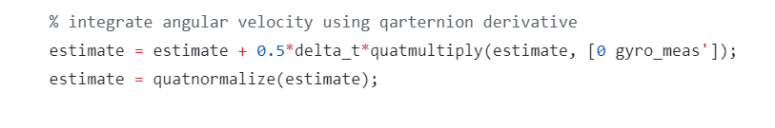
3. Attitude Estimation :
Gyroscope measurements:
To increase the fidelity of the attitude estimator process model, we incorporate the mesaurments related to the gyroscope to the propagation equations used in the prediction step of the Kalman filtering process.

Slide 11
3.1. Quaternions
Quaternions for Attitude Representation: Quaternions provide a robust and efficient method for representing spatial orientations, particularly beneficial in aerospace for handling 3D rotations without suffering from gimbal lock. A quaternion is expressed as q=q0​+iq1​+jq2​+kq3​, where q0​ is the scalar part, and [q1​,q2​,q3​]T is the vector part.
Quaternion Operations:
Basic rules for quaternion multiplication are defined to support rotation operations:
i∗i=j∗j=k∗k=−1
i∗j=k, j∗k=i, k∗i=j, and inversely, j∗i=−k, i∗k=−j, k∗j=−i
Attitude Representation via Quaternions:
Quaternion representation of rotation about an axis e by an angle θ is given by:
q0​=cos(θ/2)
q=sin(θ/2)e
This representation is key for direct computational efficiency, particularly when performing rotation composition and avoiding the computational complexity of trigonometric functions.

Slide 12
3.1. Quaternions
In many mathematical models, especially those involving vectors or angles, errors are typically represented as additive corrections. However, when it comes to quaternions, which are used to represent rotations and attitudes, additive formulations are not adequate.
The reason is that the sum of two unit quaternions (quaternions with a modulus or norm of one, representing rotations) does not necessarily result in another unit quaternion. This is crucial because any quaternion used to represent a rotation must be a unit quaternion to maintain the mathematical validity of its rotational properties.
Introduction of Multiplicative Formulation:
To address this issue, errors in quaternion-based systems are modeled multiplicatively. In this model, the true quaternion state (q) is represented as a product of an estimate quaternion (qˉ​) and an error quaternion (δq):
q=qˉ​∗δq
Here, δq represents the deviation from the estimated quaternion (qˉ​) to the true quaternion state and should be close to the identity quaternion [1,0,0,0]T in cases where the estimate is accurate.

Slide 13
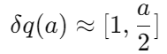
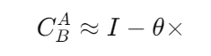
3.1. Quaternions
Error Quaternion and Degrees of Freedom:
The error quaternion δq, especially when small, can be represented using a compact vector form because it only effectively has three degrees of freedom—corresponding to small rotational errors around each axis. This is because the scalar part of a small rotation quaternion is close to 1, reflecting minimal rotation.
The vector a represents this small error, and the error quaternion can be approximated as:
Link to Direction Cosine Matrices (DCMs):
The approach of using error quaternions is analogous to adjustments typically made using small error vectors in systems that employ Direction Cosine Matrices (DCMs) for attitude representation. In DCMs, a small deviation in attitude is often represented as an additive skew-symmetric matrix constructed from the cross-product of a small angle error vector θ:
The DCM notation CBA​ indicates the matrix transforming coordinates from frame A to frame B, and the skew-symmetric matrix θ× represents an infinitesimal rotation.

Slide 14
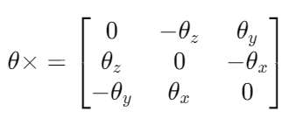
3.1. Quaternions
Details of the Cross Product Operation
Error Vector θ: This vector represents a small rotational error, where each component of θ corresponds to a small rotation around one of the three principal axes (x, y, z).
Skew-Symmetric Matrix (θ×): The cross-product matrix, or skew-symmetric matrix derived from θ, is used to express this vector as a matrix that can perform a vector cross product via matrix multiplication. The matrix form of θ is defined as:
DCM Update Approximation: The DCM, representing the rotation from frame A to frame B, is updated by subtracting the product of the skew-symmetric matrix and the DCM, reflecting the small rotations described.

Slide 15
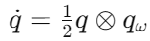
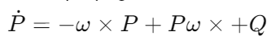
3.1. Quaternions
Quaternion Propagation in the MEKF:
The quaternion kinematic equation is employed to propagate the quaternion estimate using angular velocity ω from gyroscopes:
where qω​ is a quaternion with zero scalar part and vector part ω.
Covariance propagation is described by:
representing the process covariance update with Q as the process noise covariance.

Slide 16
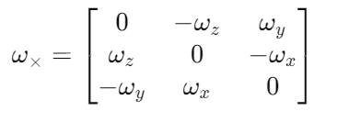
3.1. Quaternions
Breakdown of the state covariance propagation model:
ω×P and ×Pω×: These terms involve the cross-product operator but are applied in a matrix context, which is typically realized through the skew-symmetric matrix representation of the vector ω. The skew-symmetric matrix of ω is defined as:
Using the Skew-Symmetric Matrix:
When you see ω×P, it involves multiplying the skew-symmetric matrix of ω (denoted as ω×​) with the covariance matrix P. This operation effectively applies the rotational effect induced by ω to the covariance matrix from the left.
Conversely, Pω× represents the multiplication of P with the skew-symmetric matrix of ω from the right, applying the rotational effect in the opposite order.
+Q: This term adds the process noise covariance matrix Q, which accounts for the uncertainty in the model due to the randomness in the process (like sensor noise or other stochastic effects).

Slide 17
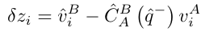
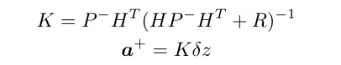
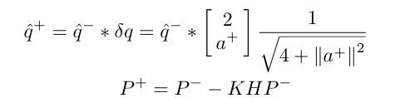
3.1. Quaternions
Mathematical Models and Update Equations:
External measurement discrepancies are calculated as:
Where C(q) is the direction cosine matrix derived from the quaternion, translating quaternion estimates into practical corrections in the state estimation.
Kalman gain K and updated error vector a+​ are derived to adjust the quaternion estimate and its covariance, ensuring that the updated estimate maintains high fidelity to the measured data.

Slide 18
4. Implementation of MEKF Matlab Code:
Overview of MEKF Code for Attitude Estimation
Initialization:
Sensor Data Loading: Gyroscope, accelerometer, and magnetometer data are loaded from CSV files, with timestamps aligned for consistent processing.
Data preprocessing: Interpolates accelerometer data to synchronize timestamps with the gyroscope using nearest neighbor extrapolation. ( In the phyphox app, the timestamps alignement is already exsited between the magnetometer and gyroscope data.)
Filter Setup:
State Definitions: The state vector includes orientation errors, velocity errors, position errors, and biases for each sensor type.
Initial Conditions: An initial guess for the device's orientation is provided (as a quaternion), along with initial covariance settings that reflect uncertainty in this initial estimate.
Output
Estimation Results: Stores the updated state estimates, including orientation in Euler angles for each time step.
Visualization: by using plots and animate functions, I am trying to envision the outputs and inputs of the MEKF at the end to judge the application and accuracy of the filter.

Slide 19
4. Implementation of MEKF Matlab Code:
Core Loop Execution:
Each iteration of the loop processes data from a single time step:
Sensor Bias Correction: Measurements from gyroscopes, accelerometers, and magnetometers are corrected by subtracting estimated biases.
Quaternion Update: The orientation quaternion is updated using a quaternion derivative approach, integrating angular velocity from the gyroscope.
Propagation Matrix (Φ) : The matrix is updated based on the current state estimate and the measurement variances, preparing for the uncertainty propagation through the system.
Measurement Update:
The Kalman gain is computed based on the current state covariance and the measurement matrix (H), which maps the state estimate into the measurement space.
Measurement residuals (errors) between expected sensor outputs and actual corrected measurements are calculated, which drive the update of the state estimate.
State and Covariance Update: The state estimate and its covariance are updated using the measurement residuals and Kalman gain, refining the orientation estimate and reducing uncertainty.
Bias Updates: Continuously refined based on measurement residuals, ensuring that sensor errors do not accumulate over time.

Slide 20
4.1. Some insights regarding the Q, Phi and H matrices
Q matrix:
The structure and specific terms of the Q matrix reflect the physical characteristics of the sensors and how their measurements' noise and biases are expected to evolve and affect the system states over time. The Q matrix in a Kalman Filter represents the covariance of the process noise.
The specific polynomial forms of the terms (linear, quadratic, cubic, etc.) are derived from the Taylor series expansion of the stochastic integrals that describe the system's evolution. This is particularly relevant in systems where the sensors' output is used in differential equations governing the system dynamics. The terms involving higher powers of delta_t are derived from integrating these effects over the sampling period, considering the cumulative and compounded impact of these errors and biases over time.
the structure of the Q matrix in your MEKF is meticulously designed to reflect both the immediate and cumulative effects of measurement noise and biases, ensuring that the filter remains robust and adaptive to the evolving state of the system.

Slide 21
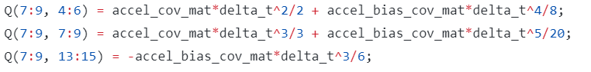
4.1. Some insights regarding the Q, Phi and H matrices
Explanation of a part of the code:
The code provided is defining specific parts of the Q matrix which deals with the relationship between position errors (state indices 7-9) and the impact of accelerometer measurements and biases.
First line models the cross-correlation between position error (indices 7-9) and velocity error. accel_cov_mat*delta_t^2/2: This term accounts for how random noise from accelerometer measurements affects position through its effect on velocity.
accel_bias_cov_mat*delta_t^4/8: This term represents the effect of accelerometer bias on position, but over a longer period. Since bias accumulates more significantly over time.
The second line describes the variance in the position error itself due to accelerometer influences.
In the third line there is a negative sign which indicates that an increase in the accelerometer bias estimation leads to a decrease in the position error estimation and vice versa.

Slide 22
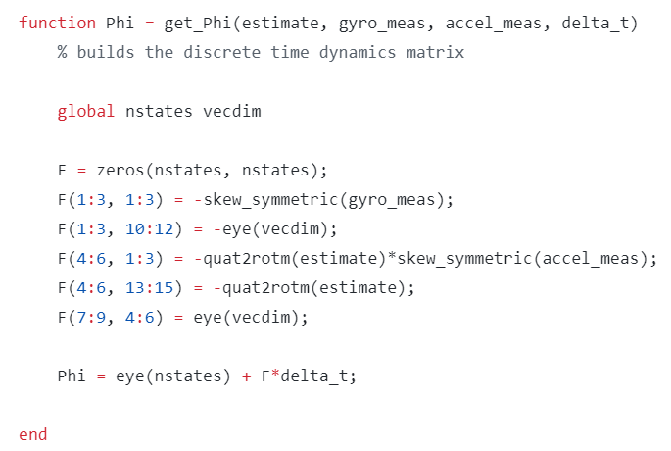
4.1. Some insights regarding the Q, Phi and H matrices
F and phi matrices: F is the Jacobian matrix capturing instantaneous system dynamics, and Phi is the state transition matrix used in the Kalman Filter to integrate these dynamics over a time step, making Phi essential for practical state prediction and updating in the filtering process. F describes the system's responsiveness to state changes instantaneously (i.e., without considering the passing of time), whereas Phi integrates this responsiveness over the interval δt​, predicting how the state evolves over that finite interval.
Construction: Phi is computed as eye(nstates)+F×δt​. This form assumes a near-identity transformation implied by eye(nstates), with corrections based on F scaled by the time step (δt​). This is essentially a first-order approximation of the exponential of F when δt​ is small, which is typical in discrete-time implementations of continuous system models.

Slide 23
4.1. Some insights regarding the Q, Phi and H matrices
The F matrix in your function get_Phi reflects the linearized dynamics of the system, focusing on how the state variables are influenced by each other under the dynamics specific to an IMU-based attitude estimation system. This approach models the real behavior of an IMU-based system, where orientation directly affects how accelerometer data is interpreted, and gyroscopes are pivotal in tracking rotational movements.
Here’s how each component relates to the physical interactions:
F(1:3, 1:3) = -skew_symmetric(gyro_meas); Orientation Dynamics: This part captures the influence of the angular velocity (measured by the gyroscope) on the orientation state.
F(1:3, 10:12) = -eye(vecdim); Gyro Bias on Orientation: Directly models the effect of changes in the estimated gyro biases on the orientation estimation inversely.
F(4:6, 1:3) = -quat2rotm(estimate)*skew_symmetric(accel_meas); Accelerometer Influence on Velocity: This term captures how changes in orientation affect the translation of accelerometer measurements into velocity updates.
F(4:6, 13:15) = -quat2rotm(estimate); Accelerometer Bias on Velocity: Similar to the above, but it models the direct impact of accelerometer bias on velocity, modulated by the orientation estimate.
F(7:9, 4:6) = eye(vecdim); Velocity to Position Integration: This part is straightforward—it indicates that velocity directly contributes to the position.

Slide 24
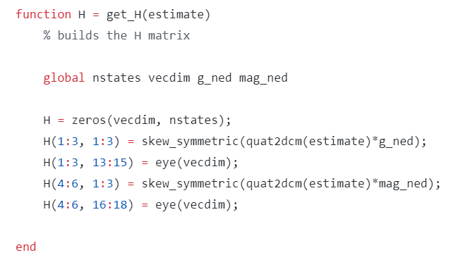
4.1. Some insights regarding the Q, Phi and H matrices
H matrix: The H matrix in a Kalman filter is the observation matrix, which maps the state vector into the measurement space.
The H matrix has dimensions (vecdim, nstates), where vecdim is the dimension of the measurement vector for each sensor type (accelerometer and magnetometer in this case, each providing three-dimensional data) and nstates is the total number of state variables in the filter. Here, vecdim appears to be 3, and nstates is the total number of states, which includes orientation, velocity, position errors, and various biases.

Slide 25
4.1. Some insights regarding the Q, Phi and H matrices
Here’s how each component relates to the physical interactions:
H(1:3, 1:3): skew_symmetric(quat2dcm(estimate)*g_ned): This part of H relates the first three state variables (presumably the orientation errors) to the accelerometer measurements. This transformation is used to model how changes in the orientation would theoretically alter the perceived direction of gravity in the accelerometer measurements.
H(1:3, 13:15): eye(vecdim) This directly maps the accelerometer bias states to the accelerometer measurements. The identity matrix implies a direct and proportional relationship.
H(4:6, 1:3): skew_symmetric(quat2dcm(estimate)*mag_ned : Similar to H(1:3, 1:3), but this relates the orientation states to the magnetometer measurements. This part of the matrix uses the orientation estimate to predict how an alteration in orientation would affect the magnetic field vector observed by the magnetometer.
H(4:6, 16:18): eye(vecdim) : Maps the magnetometer bias states directly to the magnetometer measurements, again using an identity matrix. This indicates that any bias in the magnetometer readings is added directly to the actual sensor outputs, similar to how accelerometer bias is handled.

Slide 26
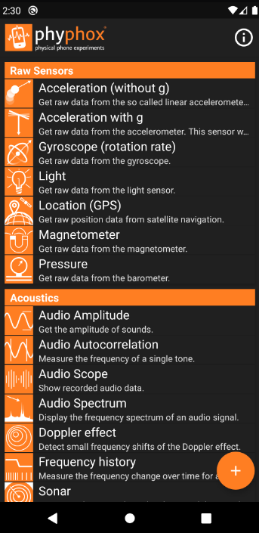
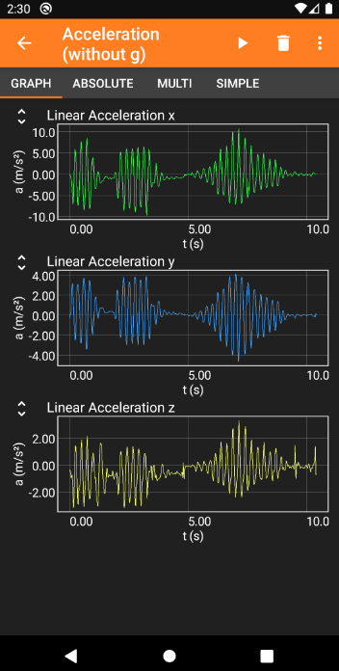
4.2. Visualizations in MEKF MATLAB Implementation
Phyphox App Overview and Integration with MEKF in MATLAB:
Introduction to Phyphox App: Phyphox (physical phone experiments) is a versatile app developed at RWTH Aachen University that transforms smartphones into mini laboratories by leveraging their built-in sensors, such as accelerometers, gyroscopes, and magnetometers. The app supports exporting data in various formats, including CSV, which is compatible with MATLAB.
Key Features:
Data Access
Export Capabilities
Custom Experiments

Slide 27
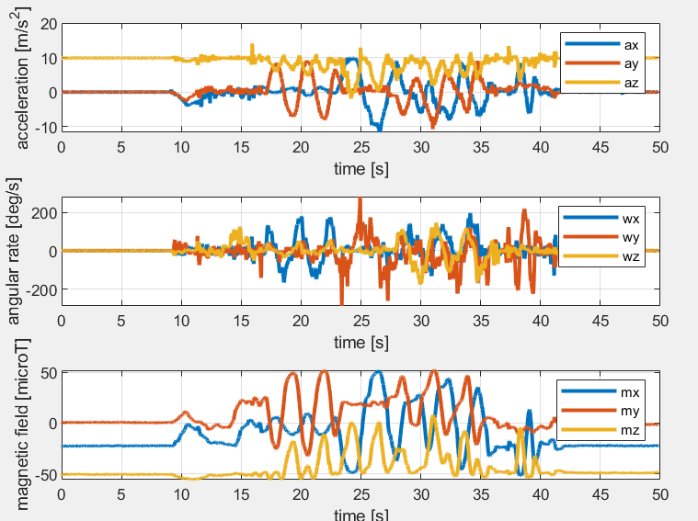
4.2. Visualizations in MEKF MATLAB Implementation
Plots Function Overview:
Sensor Data Plots:
Accelerometer Data: Shows acceleration for x, y, and z axes.
Gyroscope Data: Displays angular rates in degrees per second for x, y, and z axes.
Magnetometer Data: Visualizes magnetic field readings in microtesla for x, y, and z axes.
Estimation Output Plots:
MEKF Estimates: Plots Euler angles (roll, pitch, yaw) estimated by the MEKF, highlighting the filter's ability to deduce orientation from noisy sensor data.
Comparison to Dead Reckoning: Shows basic dead reckoning results versus sophisticated MEKF outputs, illustrating improvements in accuracy.

Slide 28
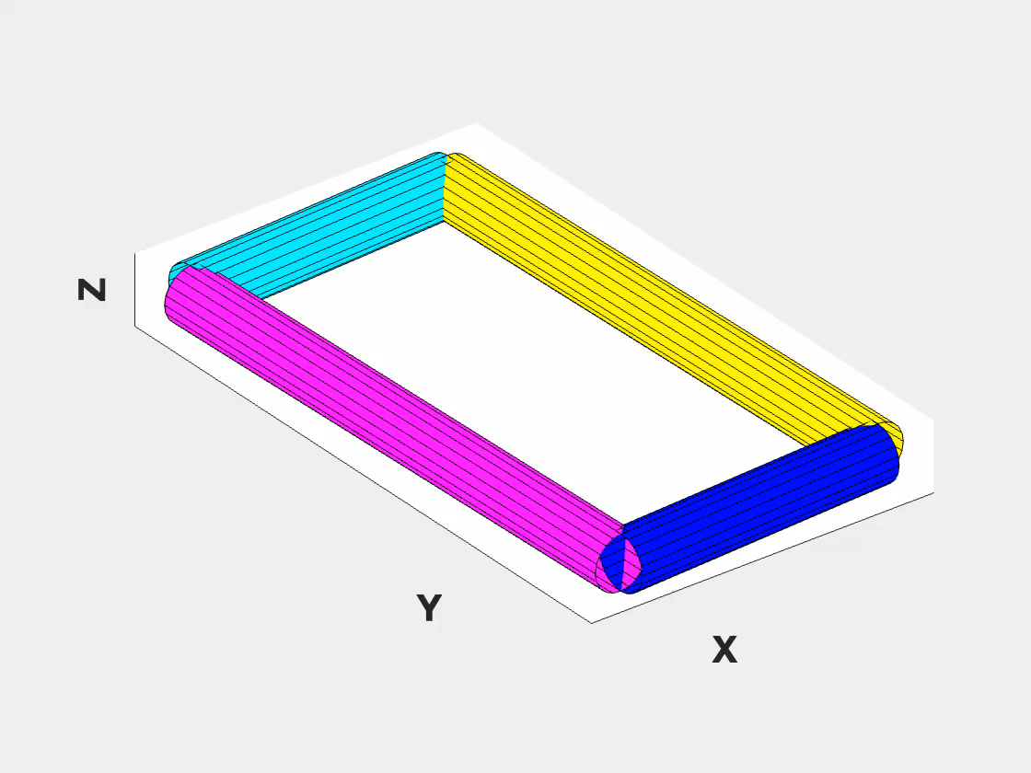
4.2. Visualizations in MEKF MATLAB Implementation
Animate Function Overview:
Purpose: Creates a dynamic 3D visualization of the estimated orientation over time.
3D Model Representation:
Constructs a simple 3D model using geometric shapes to represent the object.
Applies rotation transformations to this model based on Euler angles computed by the MEKF.
Animation Process:
Sequentially updates the model's orientation in a loop and captures frames for each update.
Compiles these frames into a video, providing a continuous visualization.

Slide 29
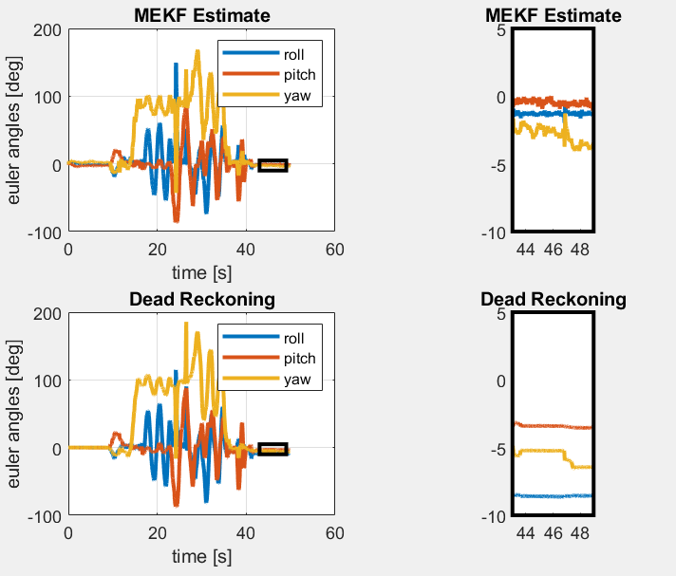
5. Conclusion
Comparative Analysis of MEKF and Dead Reckoning
Top Plots - MEKF Estimate:
Display the roll, pitch, and yaw angles estimated by the MEKF.
The left plot shows a wider time span, while the right is a zoomed-in view.
Bottom Plots - Dead Reckoning:
Reflect the same Euler angles but derived from a basic dead reckoning approach, which relies solely on integrating angular rates without correcting for sensor errors or biases.
Similar to the MEKF plots, the left shows the overall trend, and the right provides a detailed look at the selected timeframe.

Slide 30
5. Conclusion
Conclusions Drawn:
The MEKF estimates show smoother transitions and less erratic behavior compared to the dead reckoning, indicating better handling of noise and potentially more accurate orientation tracking.
The zoomed-in plots reveal that the MEKF maintains a consistent estimate over time, particularly when the dead reckoning may diverge due to uncorrected errors accumulating.
These visualizations underscore the advantages of using a sophisticated filtering approach like the MEKF, especially in scenarios where precision and reliability over time are critical.
Implications for MEKF Implementation:
The MEKF's ability to account for sensor noise and drift is evidenced by the smoother and more stable estimates, as opposed to the dead reckoning method that lacks such compensations.
This comparative visualization highlights the MEKF's robustness and validates its effectiveness in real-world applications where accurate orientation tracking is paramount.

Slide 31
Thanks for your patience!!!!!

